Slide 1
Ring Opining Polymerization ( ROP)
Dr.Widad Saleh
2nd Lecture
Characterization of ROP
1- Using cyclic monomers
2- Using ionic and free radical initiators.
3-Polymerization : transfer from intra-chain bonds to interchain bonds.
4- Polymerization with out release small molecules.
5- Polymerization with low activation energy .
6- The most important factor in the polymerization condition is thermodynamic factor.

Slide 2
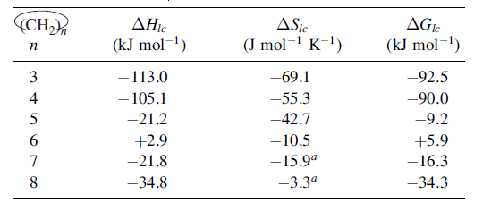
Thermodynamics of Polymerization of
Cycloalkanes at 25C
The order of thermodynamic feasibility is 3,4 > 8 > 5 , 7 for polymerization
While the thermodynamic stability was 3 ,4 < 8 < 5,7 .

Slide 3
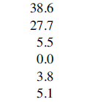
Bond angle strain
Torsional strain
Transannular strain

Slide 4
Where X may be a hetero atom such as O,S,or a group like NH,–O–CO–, –NH–CO,or–C›C–.

Slide 5
Type of Polymerization
1-Anionic Polymerization.
2- Cationic Polymerization.
3- Metathesis Polymerization
.
4-Radical Polymerization.
Depending on the types of monomer and Initiators used in the polymerization condition

Slide 6
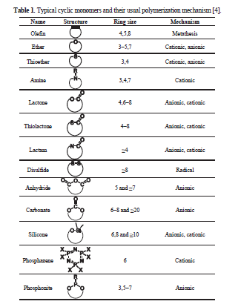

Slide 7
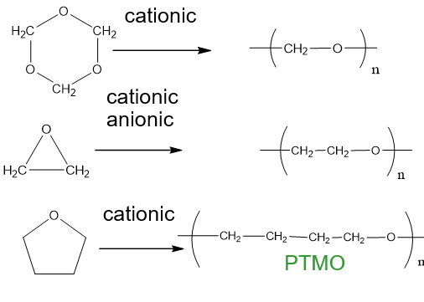

Slide 8
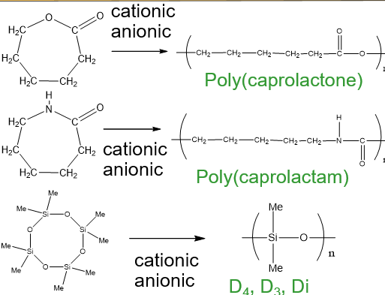

Slide 9
Cationic ROP ( CROP )
------ CROP can be initiated by Bronsted acids, carbenium ions, onium ions, photoiniators and covalent initiators.
------ Ring-opening polymerizations involving a positively charged intermediate
Initiation by Bronsted acids

Slide 10
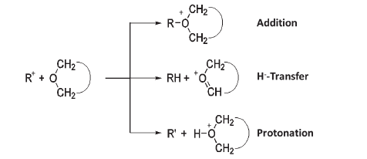
Initiation by carbonium ion
Initiation by Onium ion

Slide 11
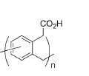
Initiation by Lewis acid
Q:- Give the mechanism for the CROP of 3-isochromanone
Q:- Give the final product for the CROP of oxitane
??????

Slide 12
Anionic ROP
Initiation step.
Symmetrical epoxide

Slide 13
For unsymmetrical epoxide
Exchange reaction
These exchange reaction lower the molecular weight of the polymers.

Slide 14
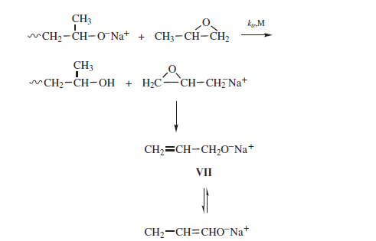
Chain transfer to monomers

Slide 15
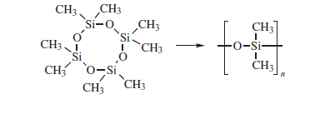
Propagation step

Slide 16
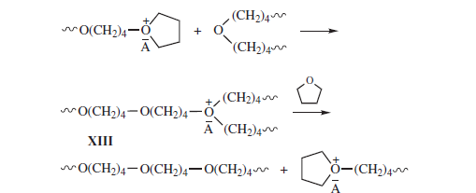
Termination step
1- Transfer Reactions
Chain transfer to polymer

Slide 17
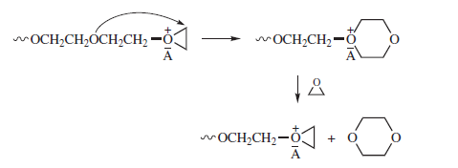
Cyclic formation

Slide 18
2- Activated monomer polymerization(AMP)
Cyclic oligomer formation can be greatly suppressed and even eliminated by carrying out cationic polymerization as an activated monomer (AM) polymerization by using an acid initiator such as BF3 or triflic acid in the presence of an alcohol

Slide 19
3- Termination reaction
Termination occurs to varying degrees by combination
of the propagating oxonium ion with either the counterion or an anion derived from the counterion.
Note:-This process depends on the stability of the counter ions , for examples :PF6 and SbCl6 have little tendency to bring about termination by transfer of a
halide ion, while counterions of aluminum and tin have appreciable transfer tendencies;
others such as (BF4Þ and (FeCl4Þ are intermediate in behavior.

Slide 20
Lactams
The polymerization of lactams (cyclic amides) can be initiated by bases, acids, and water
[Reimschuessel, 1977; Sebenda, 1976, 1978; Sekiguchi, 1984].
Cationic polymerization:-
A variety of protonic and Lewis acids initiate the cationic polymerization of lactams

Slide 21
Propagation follows in a similar manner as a nucleophilic attack by the primary amine
end group of a growing polymer chain on protonated monomer to yield final products.
Note:-Various side reactions greatly limit the conversions and polymer molecular weights
that can be achieved in cationic polymerization of lactams

Slide 22
Hydrolytic Polymerization
Hydrolytic polymerization of E-caprolactam to form nylon 6 (Sec. 2-8f) is carried out commercially
in both batch and continuous processes by heating the monomer in the presence of
5–10% water to temperatures of 250–270C for periods of 12 h to more than 24 h [Anton and
Baird, 2002; Zimmerman, 1988].

Slide 23
Propagation step
Anionic polymerization:-
Strong bases such as alkali metals, metal hydrides, metal amides, metal alkoxides, and
organometallic compounds initiate the polymerization of a lactam by forming the lactam
anion XXXIV

Slide 24
the lactam anion, is not stabilized by conjugation with a carbonyl group. The primary amine
anion is highly reactive and rapidly abstracts a proton from monomer to form the imide dimer
XXXVI, N-(E-aminocaproyl)caprolactam, and regenerate the lactam anion.

Slide 25
Lactones
Other cyclic ester

Slide 26
Cyclic amines
Cyclic Sulphur compounds

Slide 27
Cyclic siloxane compounds
D4
These cyclic compound polymerized in acidic and basic compounds to obtained polysiloxane

Slide 28
Ring opining metathesis polymerization ( cycloalkenes )
Cycloalkenes undergo ring-opening polymerization in the presence of coordination initiators
based on transition metals to yield polymers containing a double bond, for instance, cyclopentene
yields polypentenamer
Better control of the reaction is achieved by using stable, isolable metal–carbene complexes,
such as the Schrock initiators based on molybdenum and tungsten (LXIV,
Mt ¼ W, Mo) and the Grubbs initiators based on ruthenium (LXV).

Slide 29
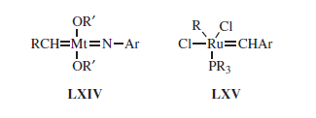
Radical Ring-Opening Polymerization( RROP)
Via a ring-opening polymerization, especially radical ROP (RROP), it is possible to produce polymers with the same or lower density than the monomers. This is interesting for applications where it is desirable to maintain a constant volume during the polymerization such as tooth fillings, coatings and accurate molding of electrical and electronic components

Slide 30
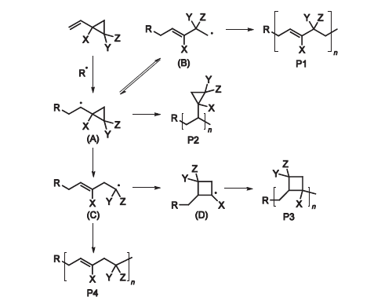
1-Vinyl Substituted Cyclic Monomers
The RROP of vinyl cyclopropane showing the competing reaction pathways

Slide 31
The RROP of phenyl (Ph) vinyl oxirane.
???
The RROP of a substituted vinyl cyclobutane.

Slide 32
2- Methylene Substituted Cyclic Monomers
The ring-opening of ketene acetals has proved to be a novel route to useful polyesters
The RROP of ketene acetals.
????
The radical polymerization of 2,2-diphenyl-4-methylene-1,3-dioxolane

Slide 33
Thank you
WIDAD SALIH

